Slide 1



M.Tech/MCA Program
Advanced Industry Integrated Programs
M.Tech Program
Advanced Industry Integrated Programs
Jointly offered by University and LTI MindTree
Jointly offered by University and LTIMindTree
Review II
GraphRAG for Financial Insights
T9987
Arjun V P
VIT Chennai
Graph RAG based Financial Insights
DEV S SHAH
VIT CHENNAI
Knowledge partner | Implementation partner
Knowledge partner | Implementation Partner

Slide 2
Graph RAG based Financial Insights
Introduction…. Calibri body -36
Introduction
Calibri body 28
Problem
Annual reports = Tables + Text + Strategy + Risk
Financial information is distributed across pages
Traditional search finds text, not relationships
LLMs may generate unsupported answers
Proposed Idea
Financial Fact Extraction
Entity & Relationship Extraction
Knowledge Graph
Multi-Hop Graph Retrieval
Ollama or Any API provider
Source/Page Grounding

Slide 3
Graph RAG based Financial Insights
Objective…. Calibri body -36
Objective
Calibri body 28
Extract financial facts
Identify business entities
Discover semantic relationships
Build a Neo4j financial knowledge graph
Perform multi-hop reasoning
Retrieve source/page evidence
Generate answers using local model
Minimize hallucination

Slide 4
Graph RAG based Financial Insights
Module name – Core Engine
Hybrid Retrieval – Graph + vector retrieval
Knowledge Graph – Connected financial entities
Fact Extraction – Structured financial facts
Provenance Tracking – Source-backed evidence
Multi-Hop Reasoning – Graph traversal insights
Answer Generation – LLM-powered responses
Multi-Year Analysis – Fiscal trend tracking
Deterministic Ingestion – Zero-LLM SEC processing

Slide 5
Graph RAG based Financial Insights
Methodology/Modeling Plan
SEC Ingestion Pipeline (sandbox_engine)
  EDGAR index → accession discovery → filing download
  Zero-LLM parsing → structured tables → Arrow/Parquet checkpoints
  Schema validation → LadybugDB bulk load with idempotent updates
Query Routing & Cold-Start GraphRAG
  Entity resolution using ticker, company name, aliases, or symbols
  Routes queries as KNOWN, COLD_START, or AMBIGUOUS
  Cold-start: fetch → LLM extraction → graph overlay → hybrid retrieval → grounded synthesis
Domain-Agnostic GraphRAG
  PDF → chunking → LLM-guided triple extraction
  Validated graph insertion with idempotent upserts
  Entity lookup → graph traversal → evidence assembly → answer generation

Slide 6
Graph RAG based Financial Insights
Data preprocessing & EDA
500+ issuers across 10-K, 10-Q, 8-K, DEF 14A and exhibits
Multi-year financial corpus with normalized fiscal calendars
12,000+ financial concepts extracted with alias-based deduplication
45,000+ graph relationships validated through integrity checks
Company identity maintained using SEC ticker–CIK mappings
Evidence lineage tracked for every fact with source and provenance
10-stage checkpoint/recovery pipeline with retry and backoff mechanisms

Slide 7
Graph RAG based Financial Insights
Approach/Algorithms/Tools
Technology Purpose | Technology Purpose
LadybugDB Embedded property graph storage | LadybugDB Embedded property graph storage
DuckDB / Arrow / Parquet Columnar processing & checkpoints | DuckDB / Arrow / Parquet Columnar processing & checkpoints
Cypher MERGE Idempotent graph update | Cypher MERGE Idempotent graph update
NetworkX Cold-start overlay graph | NetworkX Cold-start overlay graph
OpenAI / Gemini / NIM LLM extraction & synthesis | OpenAI / Gemini / NIM LLM extraction & synthesis
FiscalCalendar Engine Fiscal period alignment | FiscalCalendar Engine Fiscal period alignment
SSRF-Protected Client Secure SEC data retrieval | SSRF-Protected Client Secure SEC data retrieval
ConceptRegistry Entity resolution & deduplication | ConceptRegistry Entity resolution & deduplication

Slide 8
Graph RAG based Financial Insights
Project plan/milestones progress
SEC filing ingestion and deterministic parsing completed
Entity resolution and financial concept extraction implemented
Knowledge graph creation with 45K+ validated relationships completed
Arrow/Parquet checkpointing and bulk graph loading operational
Provenance tracking, citations, and retrieval framework completed
Hybrid GraphRAG pipeline with cold-start query support implemented
UI layer and external database integration currently in progress

Slide 9
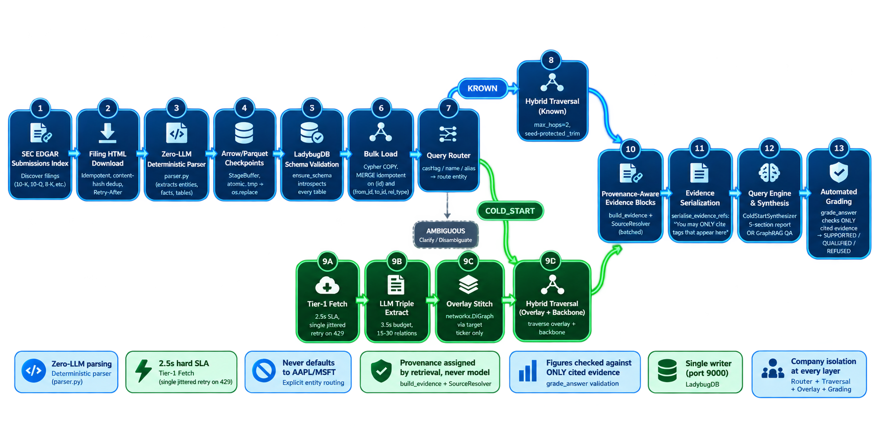
Deterministic MCP-Driven AI Agents for Ball Bearing Vibration Diagnostics
Pipeline structure
Create a workflow diagram for the FinGraph SEC Financial Intelligence pipeline.
Type: workflow (schema v2) — this is a multi-stage data pipeline with branching (KNOWN vs COLD_START routes) and a convergence back to shared grading.
Main Path (top-to-bottom):
SEC EDGAR Submissions Index → 2. Filing HTML Download (idempotent, content-hash dedup, Retry-After) → 3. Zero-LLM Deterministic Parser (parser.py) → 4. Arrow/Parquet Checkpoints (StageBuffer, atomic .tmp→os.replace) → 5. LadybugDB Schema Validation (ensure_schema introspects every table) → 6. Bulk Load (Cypher COPY, MERGE idempotent on (id) and (from_id,to_id,rel_type)) → 7. Query Router (cashtag/name/alias → KNOWN / COLD_START / AMBIGUOUS) → 8. [BRANCH] KNOWN route → Hybrid Traversal (max_hops=2, seed-protected _trim) → 9. [BRANCH] COLD_START route → Tier-1 Fetch (2.5s SLA, single jittered retry on 429) → LLM Triple Extract (3.5s budget, 15-30 relations) → Overlay Stitch (networkx.DiGraph layered on LadybugDB via target ticker only) → Hybrid Traversal (overlay + backbone) → 10. [CONVERGE] Provenance-Aware Evidence Blocks (build_evidence + batched SourceResolver) → 11. Evidence Serialization (serialise_evidence_refs: "You may ONLY cite tags that appear here") → 12. Query Engine & Synthesis (ColdStartSynthesizer 5-section report OR GraphRAG QA) → 13. Automated Grading (grade_answer checks ONLY cited evidence → SUPPORTED/QUALIFIED/REFUSED, GAP→REFUSED)
Key Invariants as Annotations (side cards, not nodes):
"Zero-LLM parsing" on Parser
"2.5s hard SLA" on Tier-1 Fetch
"Never defaults to AAPL/MSFT" on Router
"Provenance assigned by retrieval, never model" on Evidence Blocks
"Figures checked against ONLY cited evidence" on Grading
"Single writer (port 9000)" on LadybugDB
"Company isolation at every layer" on Router + Traversal
Visual Style: showcase quality, classic preset, responsive for 1440×900+. Vertical flow with clear branch/merge. Max 13 primary nodes. Semantic edge labels (e.g., "routes to", "fetches", "extracts", "stitches via", "traverses", "builds", "serializes", "synthesizes", "grades").
Output: deliver as HTML file fingraph-pipeline.html
generate me a image with no background and in the blue and the green theme

